Slide 1
Magic square

Slide 2
TRAINING PRESENTATION
Gerald Jan Balverde

Slide 3
AGENDA
Basic and Advance SQL

Slide 4

What is SQL?
Structured Query Language is the standard language used for relational database management systems (RDBMS). What is RDBMS? A database management system that manages data as a collection of tables in which all relationships are represented by common values in related tables

Slide 5
Basics
Of SQL

Slide 6

DATA MANIPULATION LANGUAGE(DML)
This manipulation involves inserting data into database
tables, retrieving existing data, deleting data from existing
tables and modifying existing data.

Slide 7
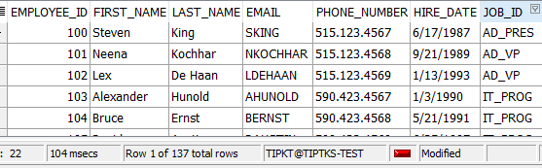
Select
SELECT statement is used to retrieve records from one or more tables in your SQL database. The records retrieved are known as a RESULT SET.
SYNTAX:
SELECT (column) FROM (table)
SELECT DISTINCT | COLUMN NAME | COLUMN ALIAS | ARITHMETIC EXPRESSIONS | || {CONCAT} | LITERALS
FROM
Ex.
SELECT employee_id,
First_name,
Last_name,
Email,
Phone_number
Hire_date
Job_id
FROM employees;

Slide 8
INSERT
INSERT statement is used to insert a one or more records into a table.
8
SYNTAX:
INSERT INTO table (column1, column2, ... )
VALUES (expression1, expression2, ... );
Ex.
insert into MyCustomers(customer_id,
customer_username,
customer_password )
values
(
1,
‘Gerald',
‘316428'
);
<- These parameters are optional if you want to encode a specific row value, otherwise encode all values

Slide 9
UPDATE
UPDATE statement is used to update existing records in the tables.
SYNTAX:
UPDATE table
SET column1 = expression1, column2 = expression2
[WHERE conditions];
Ex.
UPDATE MyCustomers
SET status = 'logged out'
WHERE customer_username = 'gerbal’;
<- Remove the WHERE clause if you want to update all values of columns in SET clause

Slide 10
DELETE
10
DELETE statement is a used to delete one or more records from a table.
SYNTAX:
DELETE FROM table [WHERE conditions];
Ex.
DELETE FROM MyCustomers
WHERE customer_username = 'gerbal’;
<- Removing this WHERE clause will delete all rows

Slide 11
Data definition language (DDL)
definition language (DDL) is a computer language used to create and modify the structure of database objects in a database. These database objects include views, schemas, tables, indexes, etc.

Slide 12
CREATE
12
CREATE TABLE statement allows you to create and define a table.
SYNTAX:
CREATE TABLE table_name ( column1 datatype Constraint
column2 datatype Constraint
Ex.
CREATE TABLE MyCustomers
(
customer_id number(10) PRIMARY KEY ,
customer_username varchar2(50) UNIQUE NOT NULL,
customer_password varchar2(50) NOT NULL,
date_created date default sysdate NOT NULL
);
<- Blue is Constraint
^ Red is data type

Slide 13
ALTER
ALTER TABLE table_name ADD column_name column_definition;
ADD A COLUMN

Slide 14
ADD A COLUMN
ALTER TABLE MyCustomers
ADD status varchar2(10) DEFAULT 'logged out'
ADD A MULTIPLE COLUMN
ALTER TABLE table_name
ADD (column_1 datatype Constraint ,
column_2 datatype Constraint ,
column_3 datatype Constraint );
MODIFY A COLUMN
ALTER TABLE MyCustomers
MODIFY customer_id number(10)
MODIFY A MULTIPLE COLUMN
ALTER TABLE table_name
MODIFY (column_1 column_definition,
column_2 column_definition,
column_n column_definition);

Slide 15
ALTER TABLE table_name MODIFY (column_1 column_type, column_2 column_type, ... column_n column_type);
DROP A COLUMN
ALTER TABLE MyCustomers
DROP COLUMN customer_id (ne need for data type)
RENAME A COLUMN
ALTER TABLE MyCustomers
RENAME COLUMN customer_id to ID
RENAME A TABLE
ALTER TABLE MyCustomers
RENAME TO CustomersNiGerb

Slide 16
DROP
DROP TABLE statement allows you to remove or delete a table from the Oracle database.
SYNTAX:
DROP TABLE [schema_name].table_name
^ schema name is optional
DROP TABLE MyCustomers

Slide 17
TRUNCATE
TRUNCATE TABLE statement is used to remove all records from a table in Oracle. It performs the same function as a DELETE statement without a WHERE clause.
TRUNCATE TABLE [schema_name.]table_name
^ schema name is optional
TRUNCATE TABLE MyCustomers

Slide 18
COMMENT
These comments can appear on a single line or span across multiple lines.
Symbol:
-- (double dash)
--select * from mycustomers
/* */
/*
CREATE TABLE MyCustomers
(
customer_id number(10) PRIMARY KEY ,
customer_username varchar2(500) UNIQUE NOT NULL,
customer_password varchar2(500) NOT NULL,
date_created date default sysdate NOT NULL,
no_of_transactions number default 0 not null
);
*/

Slide 19
CONCATINATION
SYNTAX:
SELECT COLUMN/’text’ || COLUMN/’text’ || COLUMN/’text’ AS ALIAS
FROM TABLE
<- Separated by double pipe ||
SELECT first_name || ' with last name of ' || last_name AS "FULL NAME"
FROM employees
SYNTAX:
SELECT CONCAT(COLUMN/’text’, COLUMN/’text’) AS ALIAS
FROM TABLE
<- Only accepts 2 parameters unless you use concat nesting
SELECT CONCAT(first_name, 'eyyyy') AS abccd
FROM employees

Slide 20
ALIAS
- Renames a column heading
Ex.
In SELECT clause
SELECT first_name AS pangalan,
FROM employees
Ex.
In FROM clause and WHERE clause
SELECT first_name,
department_name,
city,
country_name,
reg.climate_type
FROM employees emp,
departments dept,
locations loc,
countries country,
regions reg
WHERE EMP.DEPARTMENT_ID = DEPT.DEPARTMENT_ID and
DEPT.LOCATION_ID = LOC.LOCATION_ID and
LOC.COUNTRY_ID = COUNTRY.COUNTRY_ID and
COUNTRY.REGION_ID = REG.REGION_ID;
IN SELECT, AS is optional
Ex.
In SELECT clause
SELECT first_name pangalan,
last_name apelyido
FROM employees
CANNOT USE ALIAS OF COLUMN AS IDENTIFIER IN WHERE CLAUSE
SELECT city ciudad
FROM locations
WHERE ciudad = 'Roma'
USE “ “ when it has space, or case sensitive

Slide 21

WHERE CLAUSE
Used to limit the Rows That Are Selected

Slide 22
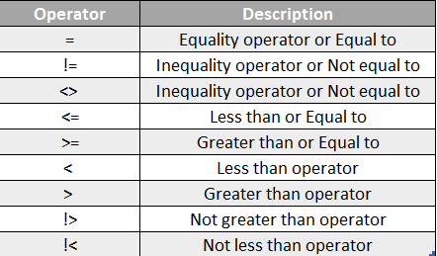
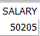
Comparison Operators

Slide 23
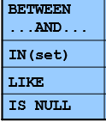
Comparison Operators
SELECT employee_id, first_name, salary as sweldo
FROM employees
WHERE not employee_id between 100 AND 150
SELECT *
FROM departments
WHERE location_id IN (1700, 2500, 2700)
SELECT city
FROM locations
WHERE city LIKE ‘_okyo’
SELECT city
FROM locations
WHERE city LIKE ‘T%’
SELECT *
FROM locations
WHERE city LIKE '%a'
SELECT *
FROM employees
WHERE first_name is null
^ Can also add a NOT, IS NOT NULL

Slide 24
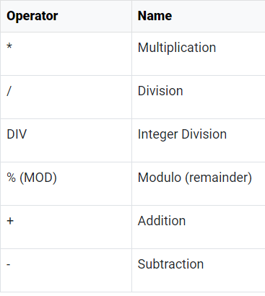
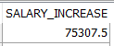

Arithmetic Operators
Arithmetic operators can be used in the SELECT, WHERE clauses. IT FOLLOWS PEMDAS
Ex.
In SELECT clause
SELECT salary + (salary * 0.5) AS salary_increase
FROM employees;
In WHERE clause
select first_name, last_name
from employees
where mod(salary, 2) = 1
--salary is odd number
^ (Power) | Raises one number by another number.

Slide 25

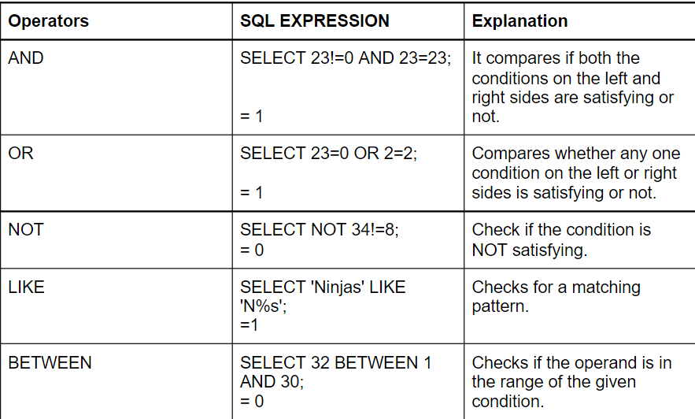
LogiCAL Operators
SELECT * FROM employees
WHERE customer_id = '10’ AND department_id = 80
SELECT *
FROM employees
WHERE job_id = 'IT_PROG' OR job_id = 'HR_REP'
SELECT *
FROM locations
WHERE NOT city = 'Roma'

Slide 26
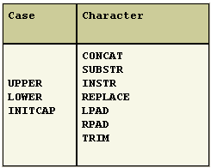
CASE & CHARACTER FUNCTIONS

Slide 27
CASE FUNCTIONS
LOWER() | Lower case all in parameter
SELECT LOWER (job_id)
FROM jobs
WHERE LOWER (job_id) = 'ad_vp'
w/ output
^ The value will depent on identifier
SELECT LOWER (job_id)
FROM jobs
WHERE job_id = 'ad_vp'
w/o output

Slide 28
CASE FUNCTIONS
UPPER() | Upper case all in parameter
SELECT UPPER (job_title)
FROM jobs
WHERE UPPER (job_title) = 'PRESIDENT'
w/ output
SELECT UPPER (job_title)
FROM jobs
WHERE job_title = 'PRESIDENT'
w/o output

Slide 29
CASE FUNCTIONS
INNITCAP() | Initialize the first letter in parameter
SELECT UPPER (job_title)
FROM jobs
WHERE UPPER (job_title) = 'PRESIDENT'
w/ output
SELECT UPPER (job_title)
FROM jobs
WHERE job_title = 'PRESIDENT'
w/o output

Slide 30
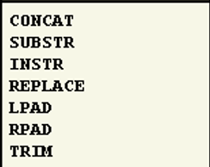
CHARACTER FUNCTIONS
TIP: Learn the parameters on each function
1st String value, 2nd Place of word, 3rd How many words will return
SUBSTR: SELECT SUBSTR (first_name, 2, 10) FROM employees
INSTR: SELECT first_name, INSTR (first_name, 'a') FROM employees
REPLACE: SELECT first_name, REPLACE (first_name, 'a', 'o’)
FROM employees
LPAD: SELECT min_salary, LPAD(min_salary, 2, '*’)
FROM jobs
RPAD: SELECT min_salary, RPAD(min_salary, 2, '*’)
FROM jobs
TRIM: SELECT TRIM( FROM 'HelloWorld') from dual
This only trim first and last word

Slide 31
JOINS
Combine tables

Slide 32
JOINS
Natural join
SELECT * FROM employees NATURAL JOIN departments
-- lahat ng common columns ay pinagsama

Slide 33
JOINS
Cross join
select * from employees cross join jobs
select * from employees, jobs
-- apply all jobs table to employee

Slide 34
JOINS
Join with USING clause
SELECT * FROM employees JOIN departments
USING (MANAGER_ID)
--kung ano ang manager_id sa departments, ibabangga sa matching manager id sa employees

Slide 35
JOINS
Join with ON clause
SELECT first_name,
department_name,
city,
country_name,
reg.climate_type
FROM employees emp
JOIN departments dept ON EMP.DEPARTMENT_ID = DEPT.DEPARTMENT_ID
JOIN locations loc ON DEPT.LOCATION_ID = LOC.LOCATION_ID
JOIN countries country ON LOC.COUNTRY_ID = COUNTRY.COUNTRY_ID
JOIN regions reg ON COUNTRY.REGION_ID = REG.REGION_ID
--with ON clause to connect with matching column from another table

Slide 36
JOINS
SELF JOIN
SELECT e.first_name emp, m.first_name mgr
FROM employees e JOIN employees m
ON (e.manager_id = m.employee_id);
Mind the on condition

Slide 37
JOINS
LEFT JOIN
select * from employees emp left join departments dep
on emp.department_id = dep.department_id
order by emp.department_id
select * from employees emp, departments dep
where emp.department_id = dep.department_id (+)
order by emp.department_id
Mind the on condition

Slide 38
JOINS
RIGHT JOIN
select * from employees emp right join departments dep
on emp.department_id = dep.department_id
order by emp.department_id
select * from employees emp, departments dep
where emp.department_id(+) = dep.department_id
order by emp.department_id
Mind the on condition

Slide 39
SUBQUERY
Just close it with parenthesis
SELECT last_name, job_id
FROM employees
WHERE job_id = (SELECT job_id
FROM employees
WHERE last_name = 'Balverde');
<- The value of this subquery is ‘IT_PROG’

Slide 40





PLAN FOR PRODUCT LAUNCH
PLANNING
MARKETING
DESIGN
STRATEGY
LAUNCH
Synergize scalable e-commerce
Disseminate standardized metrics
Coordinate e- business applications
Foster holistically superior methodologies
Deploy strategic networks with compelling e- business needs

Slide 41
TIMELINE
SEP 20XX
NOV 20XX
JAN 20XX
MAR 20XX
MAY 20XX
Synergize scalable e-commerce
Disseminate standardized metrics
Coordinate e- business applications
Foster holistically superior methodologies
Deploy strategic networks with compelling e- business needs

Slide 42



HOW WE GET THERE
ROI
NICHE MARKETS
SUPPLY CHAINS
Envision multimedia-based expertise and cross-media growth strategies
Visualize quality intellectual capital
Engage worldwide methodologies with web-enabled technologies
Pursue scalable customer service through sustainable strategies
Engage top-line web services with cutting-edge deliverables
Cultivate one-to-one customer service with robust ideas
Maximize timely deliverables for real-time schemas

Slide 43
SUMMARY
At Contoso, we believe in giving 110%. By using our next-generation data architecture, we help organizations virtually manage agile workflows. We thrive because of our market knowledge and great team behind our product. As our CEO says, "Efficiencies will come from proactively transforming how we do business."

Slide 44
THANK YOU
Mirjam Nilsson​
mirjam@contoso.com
www.contoso.com

